Slide 1
How to complete a United Way Pledge Form

Slide 2
Here is a United Way Pledge Form.

Slide 3
1st Step
Fill out #1
“My Information”

Slide 4
1. My Information
Enter your contact information in this section. This is used for recording your pledge, acknowledgements, receipts, newsletters, volunteer opportunities, birthday wishes, Loyal Contributor program, etc., as you wish. United Way does not share your information. Please be sure to check any boxes at the bottom on section 1 to receive special information that may not automatically be sent to you.

Slide 5
2nd Step
“My contribution”

Slide 6
2. My Contribution
Payroll Deduction – select your amount or enter (Other). B. How many payment periods. Multiply A x B to determine your gift for the year. This is your total payroll pledge.

Slide 8
2. My Contribution
Other Ways to Give = Cash or check. Also, Bill At Home, which means, United Way will use the address you provided in Section 1, to mail you a quarterly reminder statement at home.
Credit Card pledges are made by you directly. Log onto www.Warrencountyunitedway.org website where you will enter your credit card information directly via Paypal. You do not need a Paypal account to use this option. You will receive a receipt immediately, and United Way will be notified of your gift.
Stocks/Securities can be donated. Contact the United Way of Warren County for details.

Slide 10
Optional – how to designate:
The best way to ensure your gift is directed where its needed the most is by giving to the general fund, however, you can designate all or some of your gift to a specific United Way Impact Area (Education, Income Stability, or Health) or a United Way / Partner agency. Refer to back side of the front page of the pledge form (White copy) for details on how to designate.

Slide 11
3rd Special Recognition
United Way likes to acknowledge donors. Check the leadership group you qualify for and provide your name for recognition as a leader in Warren County.

Slide 12
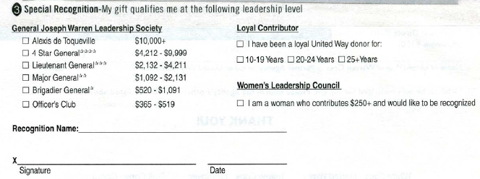
3. Special Recognition
Check the GJW category if you qualify
Check Loyal contributor # of years
Check the Women’s leadership Council if you qualify
Tell us how you would like to be recognized (Mr. and Mrs. Smith/In memory of)

Slide 13
Finalizing your pledge form
Sign your form.
Turn in the white and yellow copy to your Workplace Employee Campaign Coordinator.
Keep the Pink copy for your records.

Slide 14
Thank you!
If you have any questions, please contact your Workplace Employee Campaign Coordinator, or call the United Way of Warren County at
513-932-3987
www.warrencountyunitedway.org

